Slide 1
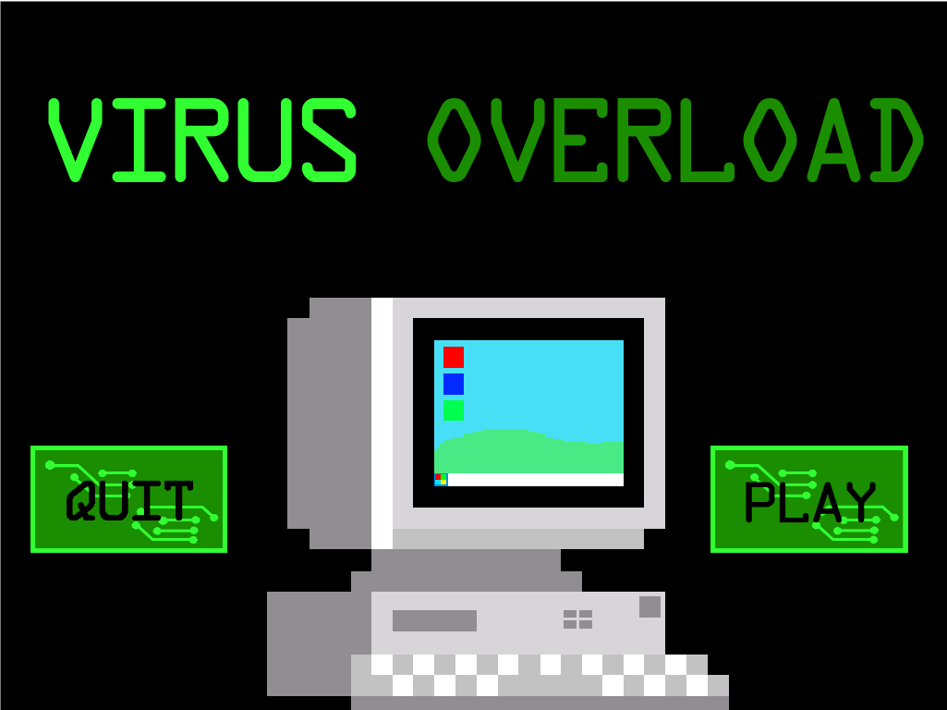
Title
Virus Overload
Visual, Audio, and Programming
Alexander Perez, 11th grade, iTECH Academy, Miami Springs SHS
Integrated Development Environment
Yoyo Games, GameMaker, GML Language
Game Platform
Windows
Game Genre
Educational, Side Scroll
Target Audience
E for Everyone, Ages 12-21 (teens - young adults)

Slide 2
What I Learned
The intricate workings of a computer and its hardware
“RAM” stands for random access memory.
Gigahertz is used to measure the speed of a processor
The most commonly known graphics card manufacturer is NVIDIA
The dangers a virus can cause in a computer system.
The precautions that must be taken in order to prevent a virus attack.

Slide 3
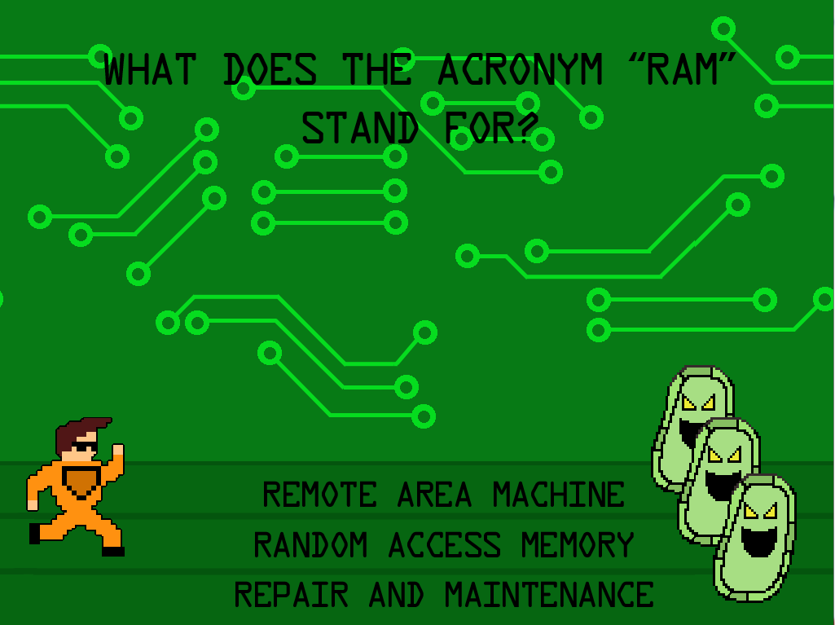
Visual Theme
16 bit graphics and animation
Outside the computer, computer user.
Inside the computer, anti-virus program.

Slide 4

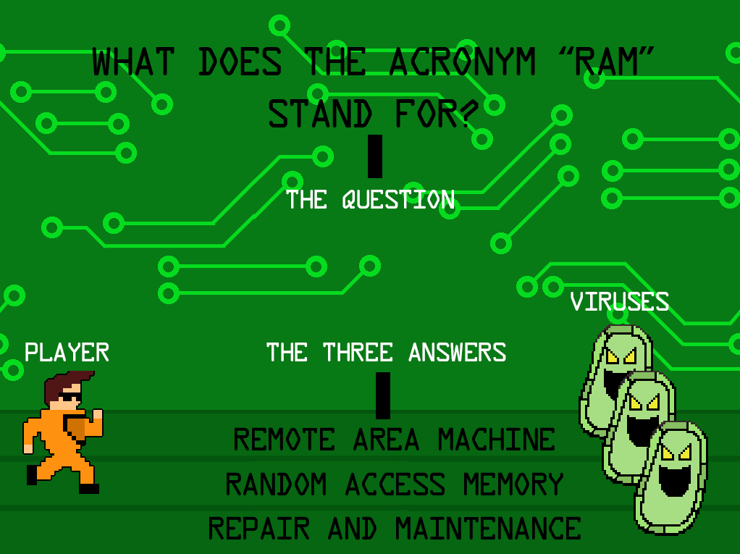
Concept and Game Mechanics
A virus has corrupted a computer that you are in charge of.
The player must answer the different computer-related questions in order to successfully terminate the virus in the system.
The player must avoid answering the question incorrectly, or risk the virus corrupting the computer.
Use the arrow keys to choose between the different available answers.

Slide 5
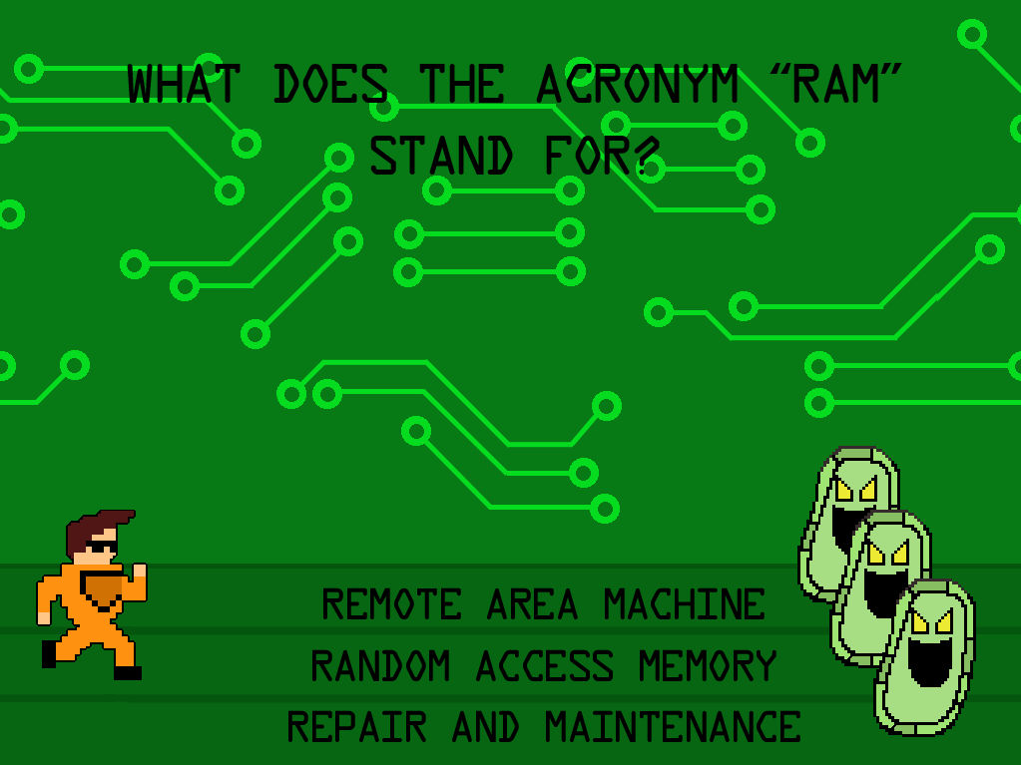
Level 1
Quest: You are the anti-virus program in the computer. You must terminate the virus from the computer.
Task: Use your knowledge in computer hardware in order to answer what RAM stands for correctly by walking into the correct lane, and attacking the virus to continue on to the next level.
Setting: Inside the computer.

Slide 6
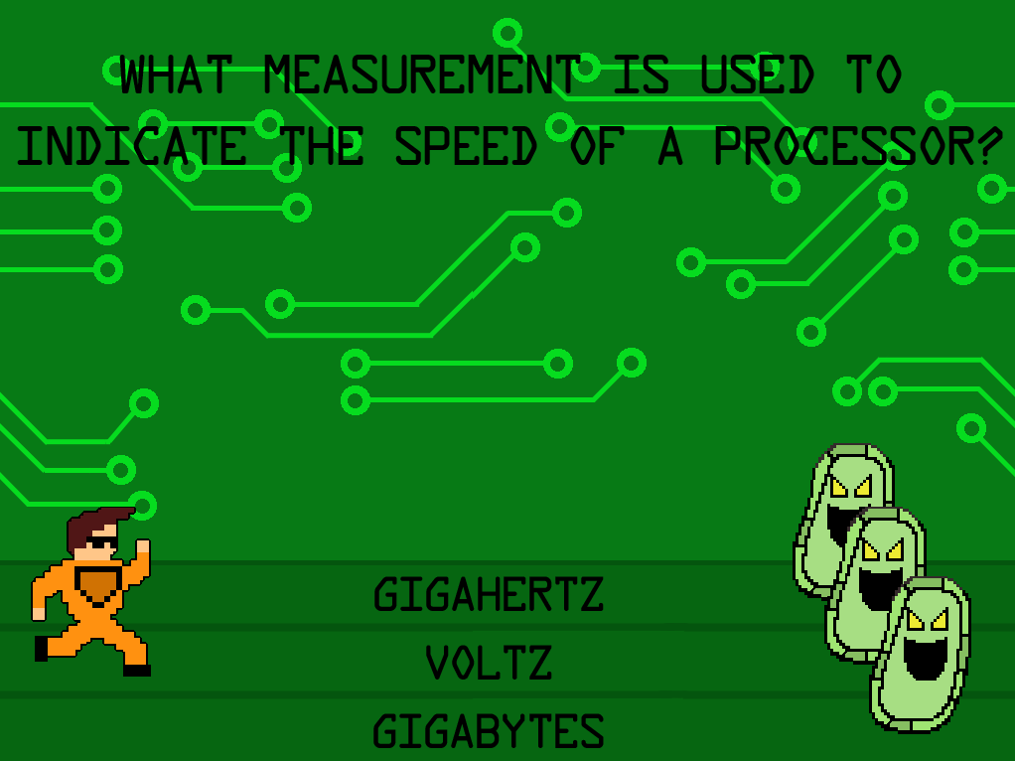
Level 2
Quest: You are the anti-virus program in the computer. You must terminate the virus from the computer.
Task: Use the same mechanics as the level one, Use your knowledge in computer hardware in order to answer the measurement used to indicate processor speed correctly by walking into the correct lane, and attacking the virus to continue on to the next level.
Setting: Inside the computer.

Slide 7
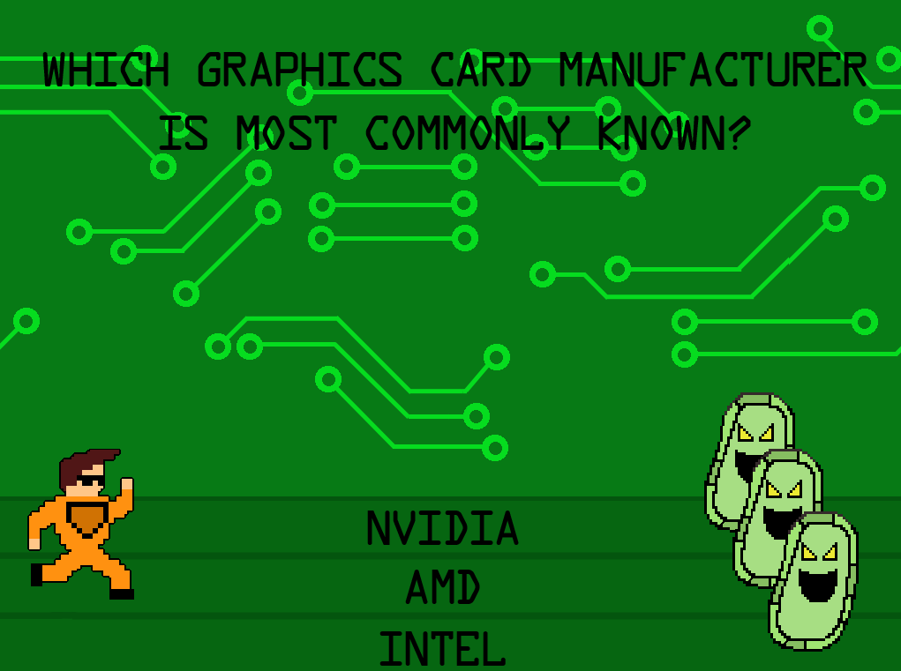
Level 3
Quest: You are the anti-virus program in the computer. You must terminate the virus from the computer.
Task: Use the same mechanics as the previous levels, Use your knowledge in computer hardware in order to answer which graphics card manufacturer is most commonly known correctly by walking into the correct lane, and attacking the virus to continue on to the next level.
Setting: Inside the computer.

Slide 8
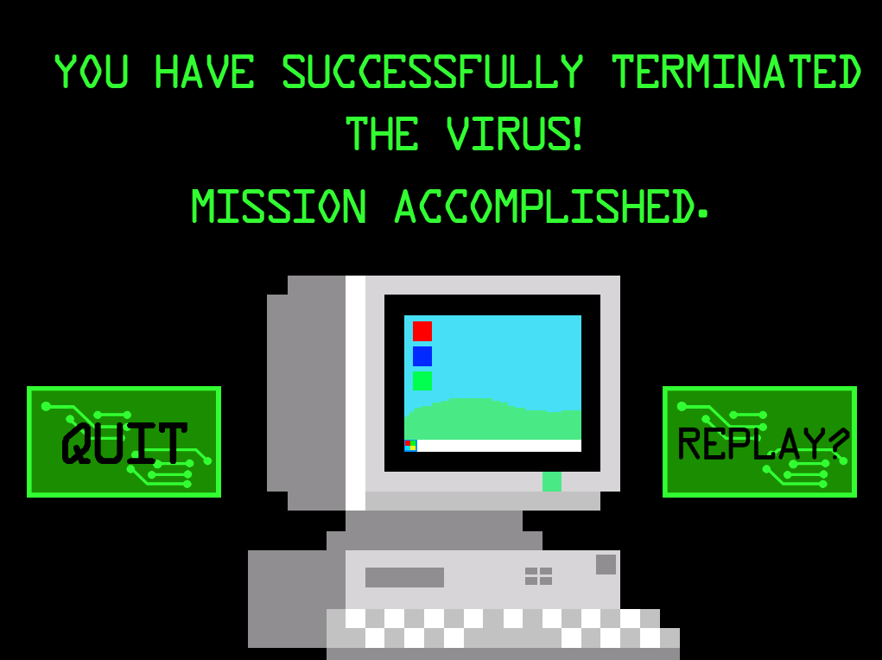
Victory Condition
Answer all the questions correctly, resulting in terminating the virus and protecting the computer.

Slide 9
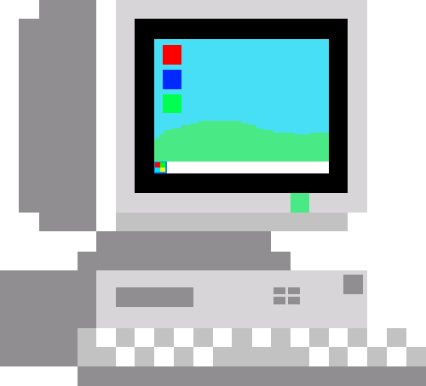


Sprites / Objects
Computer: The computer that appears at the start of the game that you must protect, and is being attacked by the virus.
Warning Computer: The sprite that appears when the virus is detected inside the computer.
Corrupted Computer: When the player answers a question incorrectly, the computer becomes overtaken by the virus and is corrupted.
Laser: This is what the player shoots at the virus to terminate it from the system.
Circuit Board Floor: This is what the avatar and the virus run on.

Slide 10


Characters
Anti-Virus Defender: He is sent by the anti-virus program to terminate the virus in the system. He is also the avatar.
Virus: This is one of the viruses in the system. If the player answers a question incorrectly, they will invade the computer and corrupt it.

Slide 11
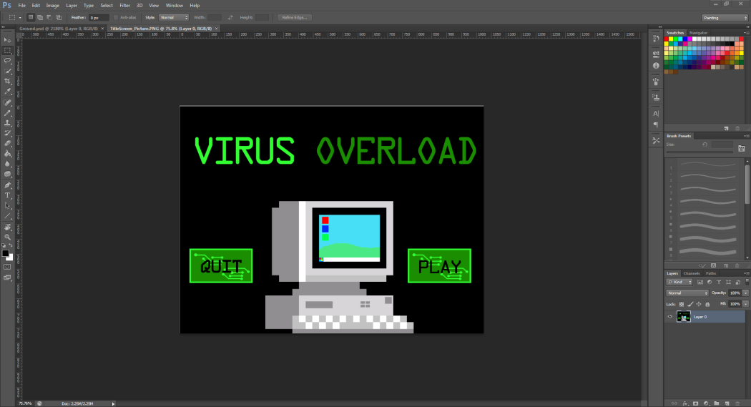
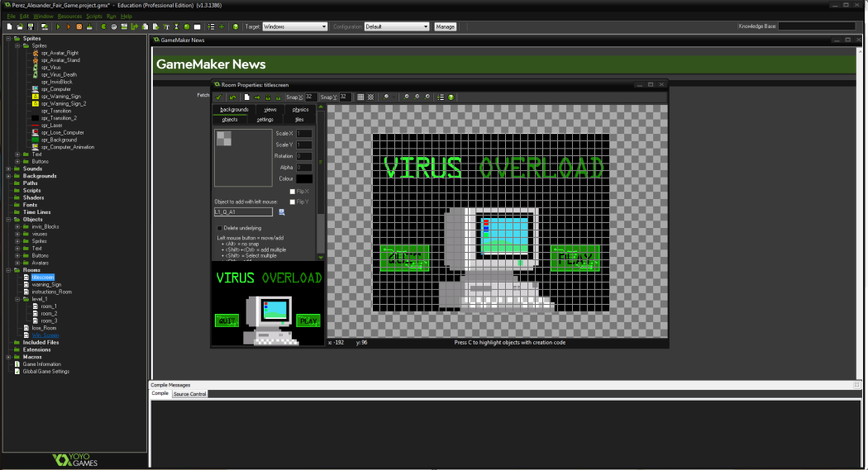
CAD / IDE
Photoshop was used to design all the textures, backgrounds, and sprites.
All the textures, backgrounds, and sprites were then implemented into Game Maker, where I applied actions to them using drag and drop events, along with small GML code.

Slide 12
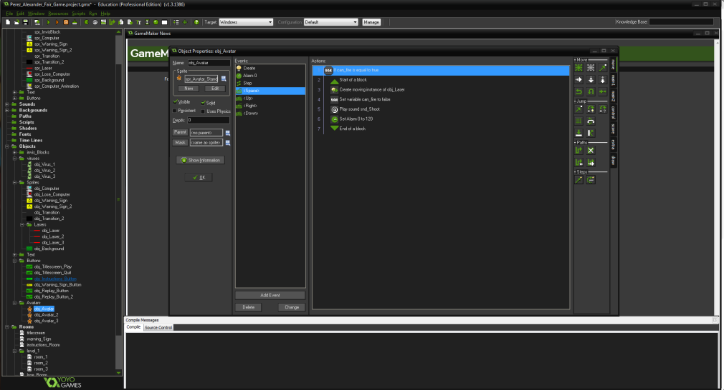
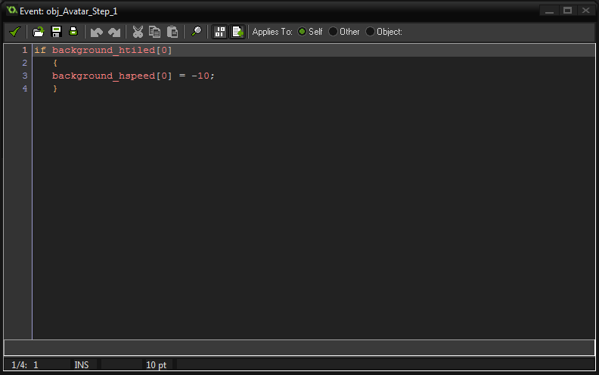
Programming and Code
Drag and drop code was used for most of the functionality of the game.
Several events that include actions that change the sprites, and declare what happens when two objects collide.
Small amount of GML code was used for some functionality.

Slide 13
Programing and Code
Below is the code I used to make the background scroll, making it seem as if the avatar were running through the computer.
The code states that if the background is horizontally placed, then set the horizontal speed equal to -10, which makes it scroll to the left.
if background_htiled[0]
{
background_hspeed[0] = -10;
}

Slide 14
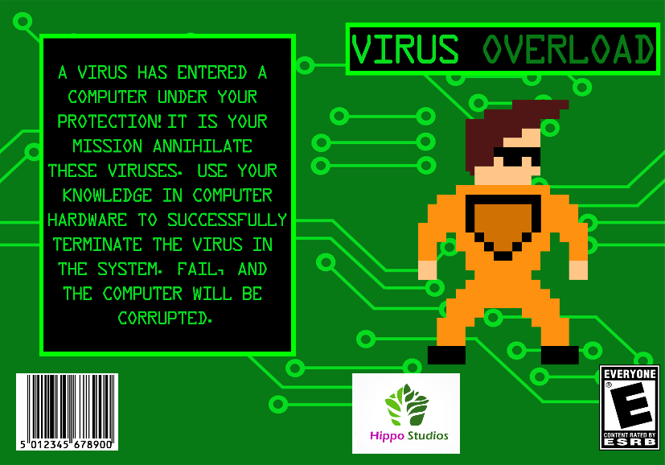
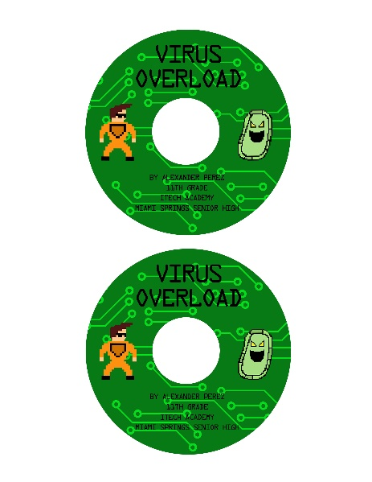
Cover Art
Photoshop was used to create both the game cover and the DVD labels.

Slide 15
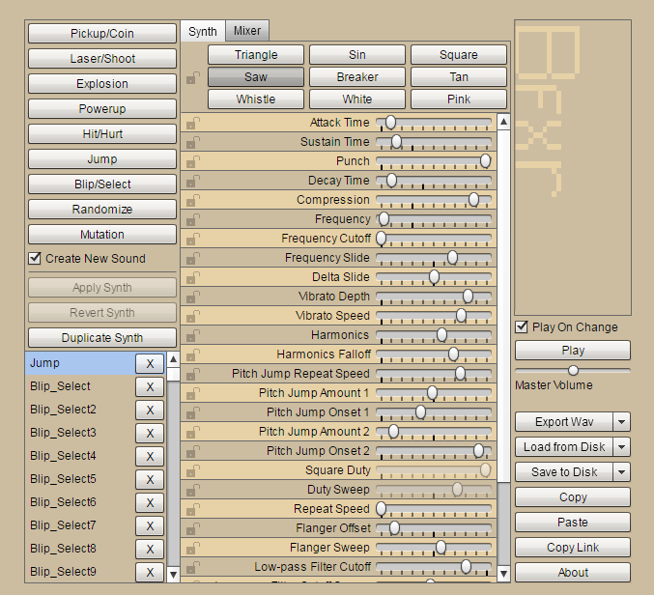
Audio
BFXR was used to create all of the sound effects in the game. BFXR is a free audio producer, so I have full rights over the sound effects that I created.
For the background music I implemented a royalty free song made by “teknoaxe” on YouTube.

